Slide 1
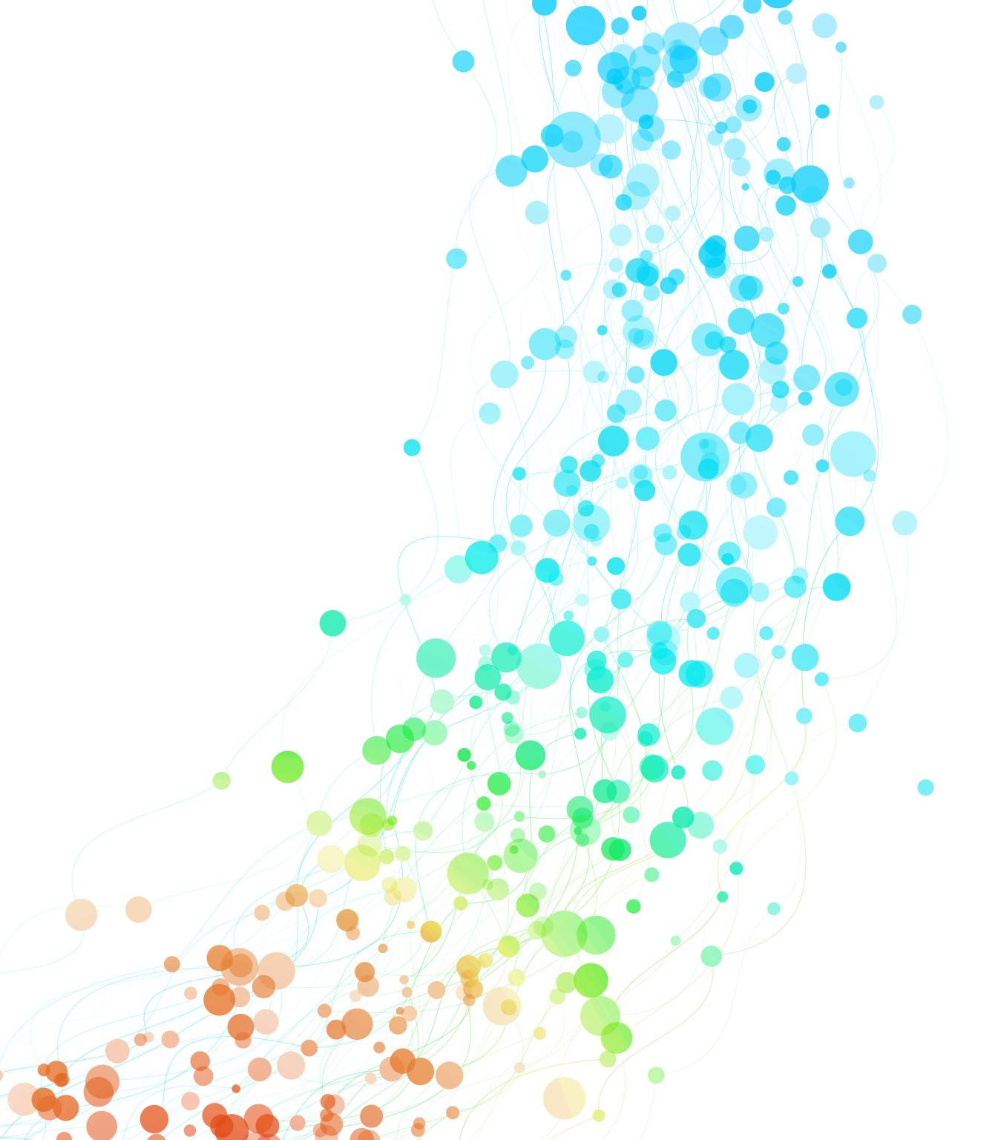
Automated Testing

Slide 2
What is a test?
In software development, "testing" is a crucial process that ensures the quality and functionality of the finished product.
It involves examining the software at various stages to identify and fix bugs, improve performance, and ensure it meets user expectations.
https://www.ionos.co.uk/digitalguide/websites/website-creation/what-does-the-404-not-found-error-mean/

Slide 3
The Testing Pyramid
Manual Testing
End-to-End Testing
Integration Testing
Component Testing
Unit Testing

Slide 4
The Testing Pyramid
Unit Testing - Testing individual units of code (functions, classes) in isolation; for example, testing views
Component Testing – Testing different functions and classes together to check if a component is working properly; for example, testing the front-end and the database separately
Integration Testing – Testing if the different components are working with each other; for example, front-end with database or front-end with google maps API
End to End Testing – Testing if the complete software is working flawlessly; for example, a site made by Django is working with all the APIs and a database
Manual Testing – Testing manually those features which are hard to write test for or are too complex to write an automated test. Automated testing is what you should always go for

Slide 5
What are automated tests?
Tests are simple routines that check the operation of your code
Testing operates at different levels
With automated tests, the testing work is done by the system
In every test we check the received output with the expected output to know if the test was passed or failed
Create a set of tests once, and as you make changes to your app, you can check that your code still works as you originally intended

Slide 6
Why create tests?
Tests save you time
Tests don’t just identify problems; they help prevent them
Tests make your code more attractive (to others)
Tests help teams work together

Slide 7
Test Driven Development (TDD)
Write a test before you actually write the code!
Seems counter-intuitive, but:
Similar to what many people do already while writing the code
Helps in describing a problem, and a code is written by being mindful to it
TDD formalizes the problem in a test case
Easier to write tests as you go along rather than to add them later
You however need to find a balance between writing a code and writing the tests

Slide 8
Template render process
Render Data
Template
Render Engine
Rendered Output

Slide 9
Template render process
<<context>>
<h1>Data</h1>
<pre>
{{ data }}
</pre>
{ ‘data' : ‘100' }
Render Engine
<h1>Data</h1>
<pre>
100
</pre>

Slide 10
The four constructs of Django Template Language
Variables:
A variable outputs a value from the context, which is a dictionary-like object mapping keys to values.
Variables are surrounded by {{ and }}
My first name is {{ first_name }}. My last name is {{ last_name }}.
With a context of {'first_name': 'John', 'last_name': 'Doe'}, this template renders to:
My first name is John. My last name is Doe.
Dictionary lookup, attribute lookup and list-index lookups are implemented with a dot notation:
{{ my_dict.key }}
{{ my_object.attribute }}
{{ my_list.0 }}
https://docs.djangoproject.com/en/5.0/topics/templates/

Slide 11
The four constructs of Django Template Language
Tag:
Tags provide arbitrary logic in the rendering process.
This definition is deliberately vague. For example, a tag can output content, serve as a control structure e.g. an “if” statement or a “for” loop, grab content from a database, or even enable access to other template tags.
Tags are surrounded by {% and %}
{% csrf_token %}
{% cycle 'odd' 'even' %}
{% if user.is_authenticated %}Hello, {{ user.username }}.{% endif %}
{% for athlete in athlete_list %}
<li>{{ athlete.name }}</li>
{% endfor %}
https://docs.djangoproject.com/en/5.0/topics/templates/

Slide 12
The four constructs of Django Template Language
Filters:
Filters transform the values of variables and tag arguments.
They look like this:
{{ django|title }}
With a context of {'django': 'the web framework for perfectionists with deadlines'}, this template renders to:
The Web Framework For Perfectionists With Deadlines
Some filters take an argument:
{{ my_date|date:"Y-m-d" }}
https://docs.djangoproject.com/en/5.0/topics/templates/

Slide 13
The four constructs of Django Template Language
Comments:
Comments look like this:
{# this won't be rendered #}
A {% comment %} tag provides multi-line comments.
<p>Rendered text with {{ pub_date|date:"c" }}</p>
{% comment "Optional note" %}
<p>Commented out text with {{ create_date|date:"c" }}</p>
{% endcomment %}
https://docs.djangoproject.com/en/5.0/topics/templates/

Slide 14
A Sample Template
Here’s what the polls/detail.html template might look like:
<h1>{{ question.question_text }}</h1> <ul> {% for choice in question.choice_set.all %} <li>{{ choice.choice_text }}</li> {% endfor %} </ul>

Slide 15
Avoiding Hardcoded Templates
The link in the polls/index.html template, was partially hardcoded:
<li><a href="/polls/{{ question.id }}/">{{ question.question_text }}</a></li>
You can remove a reliance on specific URL paths defined in your url configurations by using the {% url %} template tag:
<li><a href="{% url 'detail' question.id %}">{{ question.question_text }}</a></li>
The URL definition as specified in the polls.urls module with the URL name being ‘detail’ as defined below:
# the 'name' value as called by the {% url %} template tag path("<int:question_id>/", views.detail, name="detail"),

Slide 16
Namespacing URL names
In big Django projects there may be many apps and several may have detail views, therefore you can differentiate between the apps using namespaces
Add app_name = 'polls’ in urls.py just before the urlpatterns assignment, then namespace template tags
For example change index.html as follows:
<li><a href="{% url ‘polls:detail' question.id %}">{{ question.question_text }}</a></li>
For comparison, the older index.html template had: <li><a href="{% url 'detail' question.id %}">{{ question.question_text }}</a></li>

Slide 17
Writing a simple form
We use detail.html to show the information about every questions and to let the user make a choice through a form
<form action="{% url 'polls:vote' question.id %}" method="post"> {% csrf_token %} <fieldset> <legend><h1>{{ question.question_text }}</h1></legend> {% if error_message %}<p><strong>{{ error_message }}</strong></p>{% endif %} {% for choice in question.choice_set.all %} <input type="radio" name="choice" id="choice{{ .counter }}" value="{{ choice.id }}"> <label for="choice{{ .counter }}">{{ choice.choice_text }}</label><br> {% endfor %}
</fieldset>
<input type="submit" value="Vote"> </form>

Slide 18
How it works
Let’s look at the first line and decipher what is going on
<form action="{% url 'polls:vote' question.id %}" method="post">
The user interacts with the form elements which in this case is a radio button
When they submit the form, the browser sends a POST as specified in method = “post”
The generated URL points to the vote view function as defined in the URLconf, passing the question.id as a parameter
The vote view function would then handle the form data, process the vote, and generate an appropriate response

Slide 19
How it works
Since we’re creating a POST form (which can have the effect of modifying data), we need to worry about Cross Site Request Forgeries. We do this by using the following tag
{% csrf_token %}
Cross-site request forgery (CSRF), also known as XSRF or Sea Surf, is a type of web security vulnerability that tricks an authenticated user into unknowingly performing an action on a website they're logged into.
Since the user is already logged into the vulnerable website, their browser automatically sends their cookies and other authentication information along with the attacker's forged request.
Luckily, by adding the csrf_token tag, Django takes care of this vulnerability

Slide 20
Updating vote method
We update views.html to manage the submitted data
def vote(request, question_id): question = get_object_or_404(Question, pk=question_id) try: selected_choice = question.choice_set.get(pk=request.POST["choice"]) except (KeyError, Choice.DoesNotExist): # Redisplay the question voting form. return render( request, "polls/detail.html", { "question": question, "error_message": "You didn't select a choice.", }, ) else: selected_choice.votes += 1 selected_choice.save() return HttpResponseRedirect(reverse("polls:results", args=(question.id,)))
We are using the reverse() function in the HttpResponseRedirect constructor in this example. This function helps avoid having to hardcode a URL in the view function. It is given the name of the view that we want to pass control to

Slide 21
Writing the results method
We write the results method in views.html
def results(request, question_id): question = get_object_or_404(Question, pk=question_id) return render(request, "polls/results.html", {"question": question})
This is almost exactly the same as the detail() view with the exception of the template name which is detailed next

Slide 22
Writing the results method
The polls/results.html template is defined as:
<h1>{{ question.question_text }}</h1>
<ul>
{% for choice in question.choice_set.all %}
<li>{{ choice.choice_text }} -- {{ choice.votes }} vote{{ choice.votes|pluralize }}</li>
{% endfor %}
</ul>
<a href="{% url 'polls:detail' question.id %}">Vote again?</a>

Slide 23
Writing Population Script
Create file populate_polls.py in main project directory
import os
os.environ.setdefault('DJANGO_SETTINGS_MODULE’ , 'mysite.settings')
import django
django.setup()
from polls.models import Question, Choice
from datetime import datetime
from pytz import utc
def populate():
question1_choices = [
{"choice_text": "The sky", "votes": 5},
{"choice_text": "Just hacking", "votes": 8},
{"choice_text": "Not much", "votes": 2},]
... # similarly for questions 2-5

Slide 24
Writing Population Script continued …
questions = {"What's up?": {"choices":
question1_choices, "pub_date":
datetime(2020, 10, 17, 15, 30,
tzinfo=utc)},
...
# similarly for questions 2-5
}
for question, question_data in questions.items():
q = add_question(question,question_data["pub_date"])
for c in question_data["choices"]:
add_choice(q, c["choice_text"], c["votes"])

Slide 25
Writing Population Script continued …
def add_question(question_text, pub_date):
question = Question.objects.get_or_create(question_text=question_text, pub_date=pub_date)[0]
question.save()
return question
def add_choice(question, choice_text, votes):
choice = Choice.objects.get_or_create(
question=question, choice_text=choice_text, votes = votes)[0]
choice.save()
return choice
# Start execution here!
if __name__ == '__main__’:
populate()

Slide 26
-END-

